Slide 1
SimpSymps:
The Symptom Checker
Intermediate Programming with Python - 90819
Python Pind: Anum Malik, Hajra Shahab, Mohammad Mansur, Mohammad Mirza, Sheharyar Ahmad

Slide 2
Agenda
Project Description
Data Sources
Libraries
Techniques
Demo
Limitations & Future Work

Slide 3
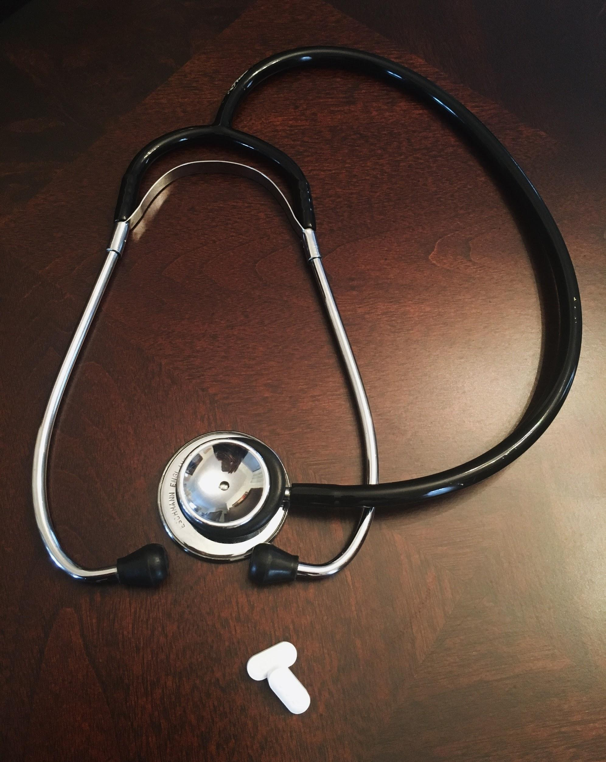
Project Description
COVID ‘19 and overburdened healthcare system
80% of internet users look online for health information, making it the third most popular activity behind email and search
Objectives:
Obtain a list of diseases from reliable online sources
Allow the user to retrieve more information, such as causes, and prescribed treatment
Reference list of a panel of doctors or hospitals based on user’s location

Slide 4
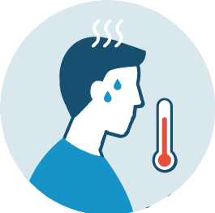



Features
Diagnose disease
Find a pharmacy/hospital nearby
Find a doctor online
Check symptoms

Slide 5
Data Sources
Symptoms List:
WebMD- https://symptoms.webmd.com/
Disease Information:
Healthline- https://www.healthline.com/
Wikipedia - https://www.wikipedia.org
Doctors (Tele-medicine) Information:
Healthgrades- https://www.healthgrades.com/specialty-directory
Google Maps for Address/Contact Information:
https://maps.googleapis.com/maps/api/place/details/json?placeid=
https://maps.googleapis.com/maps/api/geocode/json
https://maps.googleapis.com/maps/api/place/nearbysearch/json?location=

Slide 6
Libraries
Techniques
BeautifulSoup
Regex
Pandas
JSON
Matplotlib
Web scraping
API calling
Exporting CSV file

Slide 7
User Instructions and Interface
Welcome Menu
Enter your most prominent/visible symptom
System will match and display additional symptoms to check
After confirmation of symptoms, Top 5 diagnosis for your symptoms displayed
Post Diagnosis the chatbot will ask whether you want to receive information related to pharmacies/doctors
Select either pharmacy/hospital or search for a doctor nearby
If you choose pharmacy or hospital, enter zip code or location. If doctor, enter specialty
Download CSV to computer (diagnosis, list of pharma/doctor/hospital)

Slide 8
Demo
Now we’d like to switch to Python for a quick demo of our chatbot!

Slide 9
A Health-Care Revolution? (probably not)
Future Work:
Include targeted diagnosis: age, gender, weight, body parts, etc.
Share past medical condition:
Retrieve data from multiple data sources
Locate pharmacies with prescribed medication only- via inventory list
Allow one-to-one online consultation with a doctor.

Slide 10
THANK YOU!

